Slide 1
Ssh-->Unmount

Slide 2
New User Creation
1.Create new user in Linux and login to that new Account
$ sudo adduser remo
$ sudo passwd remo (Please do specify user name )
Enter the password: Remo@123
Retype the passwd :Remo@123
2.How to switch from one user to another user in Linux
su – remo
Password: remo@123

Slide 3
ssh
Ssh
it is used to connect to remote server
ssh username@hostname/IP(servername)
Password: *******
Example: admin@fr712uappdever.net.ere
econi@simi345batprod07server
Ec2-user@124.44.56.63

Slide 4
To find the hostname of server
hostname
Ssh username@server2
Password:
Hostname : Will provide DNS name( Domain Name System) purpose is to uniquely identify over a network.
Ssh uses port 22 by default.

Slide 5
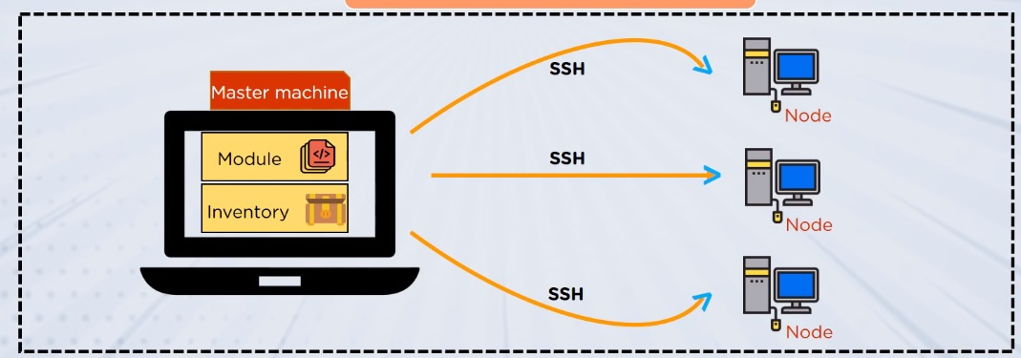
Connect to Remote Server

Slide 6
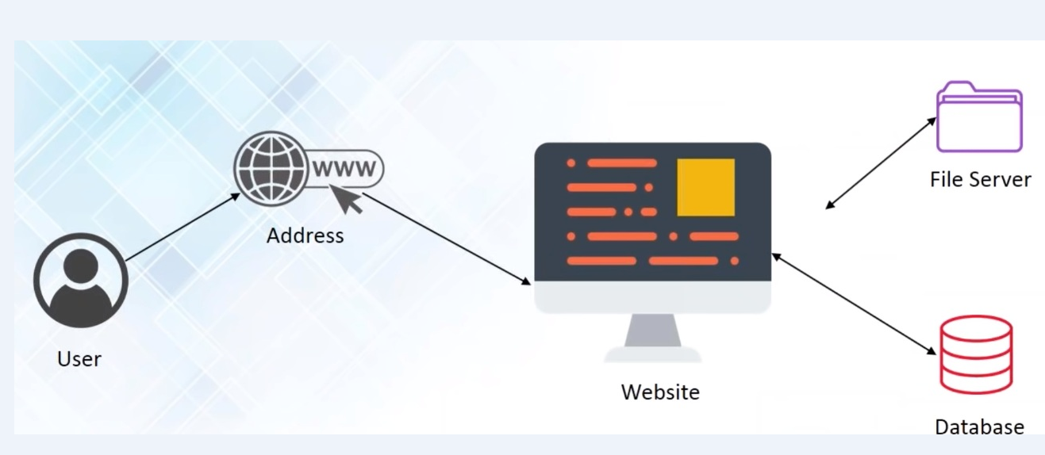
Basic functionality

Slide 7
Scp
Scp
is used to copy file or dir from one server to another server.
Scp file(log.txt) username@server2:/home/dir1/dir2/
Password:
Scp –r dir1 username@server2:/home/../../
Scp –p file1 username@server2:/home/../../
P is preserved permission as same

Slide 8
Rsync
rsync is used to copy files from one server to another server and also within the server, while copying the data if copy is stopped due to network issues in between, if I use ‘scp’ it will start copying from begin
if I use rsync it will start copying from where it is stopped.
Rsync file username@server2:/home/test/../
If you want to copy with in the server
Syntax: Rsync src dest

Slide 9
Ping
Is used to check whether the server is up and down
Syntax:Ping ip
Syntax:ping hostname
telnet :it uses port 23
By Using telnet we can Test Open Ports,
Syntax:telnet ip or hostname

Slide 10
Su & sudo
su
super user
su –root or su –sonu
used to login as root user
Root has highest permission
superuser does
adduser abc-user
is used to run command with root permissions
sudo username

Slide 11
who
who
How many users are logged into the the system.
who
who | wc -l
whoami
is used to check your login name

Slide 12
uname
uname
to check linux version
uname –a
complete information about linux
uname –v
version and time of linux

Slide 13
Ps & Kill
ps
is used to list current running process on a system
ps –ef | grep ―system32
kill
used to stop process
-9 is a special signal to terminate that process
Kill -9 PID
Killall -9 pname
sudo service servername/Pname stop
Sudo service servername/Pname start
Sudo service servername/Pname restart
Pkill -9 –u ―username – stop process started by particular user
Ps –u username – list process started by particular user
ps –ef | grep “system32”

Slide 14
Sort & Uniq
sort is used to sort the data
sort filename
sort –r filename
uniq
used to print only unique values (it removes duplicate) ,it will work only when the contents/data are consecutive values/info/data
uniq will be always used with the sort
uniq filename
cat file | sort | uniq

Slide 15
.bashrc file
.profile / .bashrc
It is an auto execute file which gets executed automatically as soon as you logged into the system.

Slide 16
Netstat & Mount
Netstat
netstat (network statistics) is a command-line tool that displays network connections (both incoming and outgoing), routing tables, and a number of network interface statistics.
Mount
Attaches a filesystem, located on same device or other to a file tree.
Mount –t type device dir
Unmount-detaches the specified file system from file hierarchy.

